Slide 1
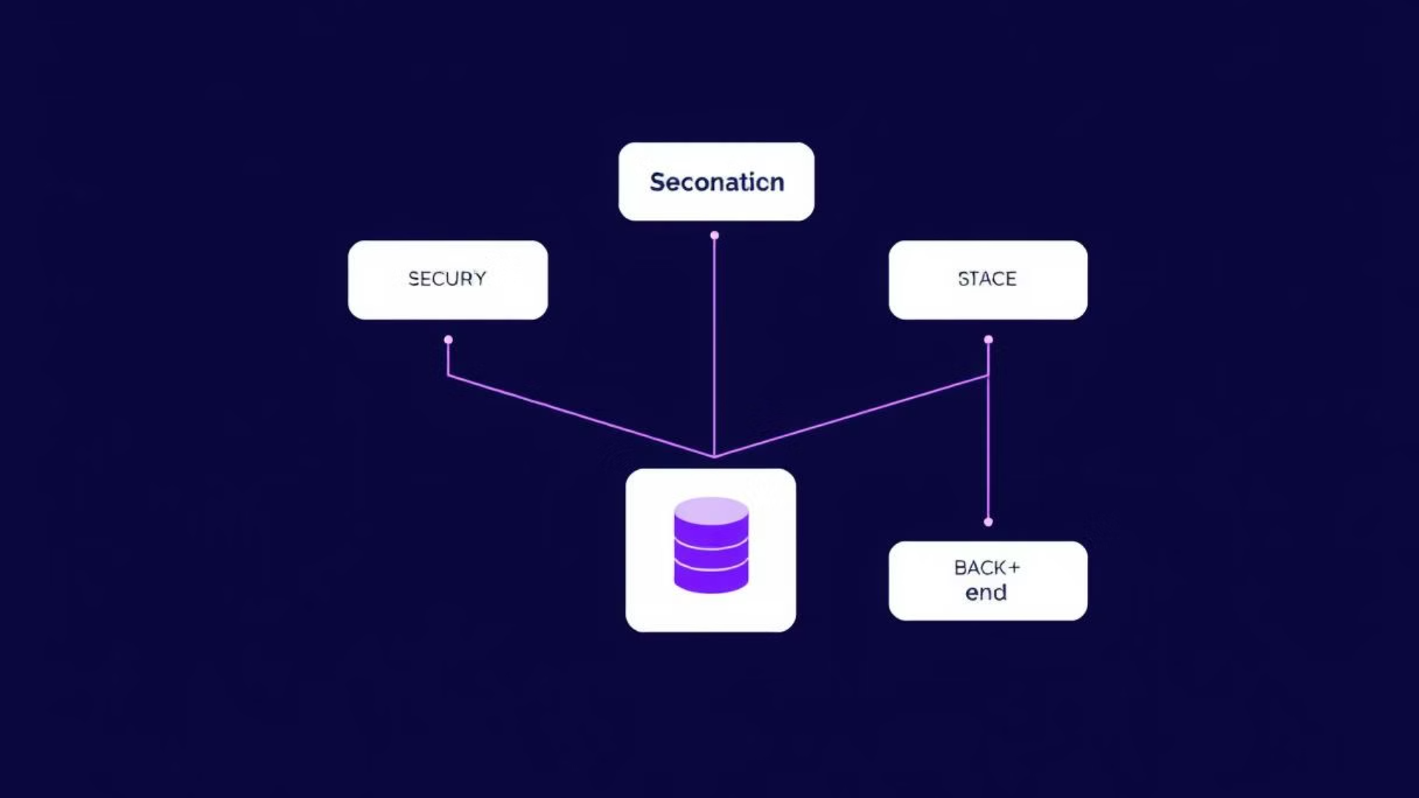
Software Functional Design (SFD) Document: Role-Based Task Management System
This document provides a comprehensive functional design for a role-based task management system. It outlines the system's architecture, components, roles, permissions, authentication, authorization, task management flow, and security considerations. The system leverages Keycloak for authentication, CASL for authorization, NestJS for the backend, MongoDB for the database, and Next.js with NextAuth for the frontend, ensuring a secure, scalable, and flexible solution for managing tasks within an organization.
Development Team & Project mangers : - Mohamed Lazraq
- Fadwa Ait Baali
- Abdelaziz Kazoum

Slide 2
Project Overview and Objectives
The Role-Based Task Management System is designed to efficiently manage tasks assigned to employees within an organization. This system implements role-based access control (RBAC) to ensure that users have appropriate access levels based on their roles. The system integrates several key technologies: Keycloak for authentication, CASL for authorization, NestJS as the backend framework, MongoDB as the database solution, and Next.js with NextAuth as the frontend framework.
The primary objectives of this project include:
Secure authentication using Keycloak to verify user identities and manage login sessions.
Role-based authorization using CASL to control access to various system functionalities based on user roles.
Efficient task assignment and tracking to ensure tasks are properly distributed and monitored.
Dynamic role and permission management to allow administrators to easily update and manage user access rights.
By achieving these objectives, the system aims to provide a robust and user-friendly platform for managing tasks within the organization while maintaining high levels of security and control.

Slide 3
System Architecture and Components
The system architecture is designed to provide a clear separation of concerns, with distinct components handling specific functionalities. This modular design enhances maintainability and scalability.
The technology stack includes:
Backend: NestJS, Keycloak, MongoDB, CASL
Frontend: Next.js, NextAuth
Authentication: Keycloak
Authorization: CASL
The main system components are:
Authentication Service (Keycloak): This component handles user authentication, including login, logout, and user management. Keycloak provides a centralized authentication solution, ensuring consistent security policies across the system.
Task Management Service (NestJS): This service is responsible for managing tasks, including task creation, assignment, and status updates. Built with NestJS, it provides a scalable and maintainable backend for handling task-related operations.
Role & Permission Management (Keycloak + CASL): This component controls access to various parts of the system based on user roles and permissions. Keycloak manages the roles, while CASL enforces the permissions within the application logic.
Frontend Interface (Next.js): The frontend provides a user interface for users to manage tasks and roles. Built with Next.js, it offers a responsive and interactive user experience.

Slide 4
Roles and Permissions
The system defines several roles, each with specific permissions to ensure that users have appropriate access levels. Here's a detailed breakdown of the roles and their corresponding permissions:
Role
Description
Permissions
Admin
Full control over the system
Manage users, roles, and permissions, assign tasks, view all data, delete/edit anything
Manager
Oversees a specific team/department
Assign and review tasks, view reports, manage team members
Employee
Works on assigned tasks
View tasks, update status, request assistance
Guest
Has limited access
View public job offers, register
The following table outlines the permission mapping, detailing which roles are assigned to each permission:
Permission
Description
Assigned Roles
manage_users
Create, update, delete users
Admin
manage_roles
Assign roles and permissions
Admin
assign_tasks
Assign tasks to employees
Admin, Manager
edit_tasks
Modify task details
Admin, Manager
view_tasks
View assigned tasks
Admin, Manager, Employee
update_task_status
Mark tasks as completed/in-progress
Employee
view_reports
Access reports and statistics
Admin, Manager
profile_management
Edit personal details
Admin, Manager, Employee
view_public_content
View public job offers
Guest

Slide 5
Authentication and Authorization Workflow
The authentication and authorization processes are critical for ensuring the security of the system. Keycloak and CASL are used in tandem to manage user access and permissions effectively.
Authentication with Keycloak
Users authenticate via Keycloak, which manages user credentials and authentication sessions.
Upon successful authentication, Keycloak issues a JWT (JSON Web Token) containing user roles and other relevant information.
The frontend uses NextAuth to store and manage authentication sessions securely. NextAuth integrates seamlessly with Keycloak to handle token storage and session management.
Authorization with CASL
CASL (Client-side Authorization Library) is used in NestJS to control backend access, ensuring that only authorized users can access specific resources and functionalities.
CASL is also implemented in Next.js to hide UI elements from unauthorized users, providing a seamless and secure user experience.
This dual-layer approach ensures that both the frontend and backend enforce role-based access control, minimizing the risk of unauthorized access and enhancing overall system security.

Slide 6
Task Management Flow and Statuses
The task management flow outlines the lifecycle of a task from creation to completion, ensuring that tasks are properly assigned, executed, and reviewed. The following steps define the task lifecycle:
Task Creation: An Admin or Manager creates a new task with relevant details such as description, priority, and due date.
Task Assignment: The task is assigned to an employee who is responsible for its execution.
Task Execution: The assigned employee works on the task and updates the task status as they progress.
Task Review: A Manager or Admin reviews the completed task to ensure it meets the required standards.
Task Completion: Once the task is approved, it is marked as completed.
The system defines several task statuses to track the progress of each task:
Pending: The task has been assigned but not yet started.
In Progress: The task is currently being worked on.
Completed: The task has been finished by the employee.
Reviewed: The task has been reviewed and approved by a Manager or Admin.
These statuses provide a clear and concise overview of the task's current state, allowing for efficient monitoring and management of tasks within the system.

Slide 7


Role and Permission Management Implementation
The system provides robust mechanisms for managing roles and permissions, allowing administrators to dynamically adjust user access rights. The implementation involves several key steps:
Assigning Roles in Keycloak
Administrators use the Keycloak Admin Panel to assign roles to users. The Keycloak Admin Panel provides a user-friendly interface for managing users and their roles.
Roles are stored in Keycloak and fetched via API when needed. This ensures that role information is centralized and consistent across the system.
Fetching User Roles in Next.js (NextAuth)
After a user logs in via Keycloak, NextAuth retrieves the user's roles from the JWT token.
The JWT token contains the role data, which is securely transmitted from Keycloak to the frontend.
Role-Based UI Management in Next.js (CASL)
CASL is used to hide UI elements for unauthorized users, providing a tailored user experience based on their roles. For example:
import { useAbility } from '@casl/react'; import { AbilityContext } from '@/lib/ability'; const TaskButton = () => { const ability = useAbility(AbilityContext); if (!ability.can('assign\_tasks', 'Task')) { return null; } return
Role-Based API Protection in NestJS (CASL)
CASL is also used to restrict API access in NestJS, ensuring that only authorized users can access specific endpoints. For example:
import { CanActivate, ExecutionContext, Injectable } from '@nestjs/common'; import { AbilityFactory } from './ability.factory'; @Injectable() export class PermissionsGuard implements CanActivate { constructor(private abilityFactory: AbilityFactory) {} canActivate(context: ExecutionContext): boolean { const request = context.switchToHttp().getRequest(); const user = request.user; const ability = this.abilityFactory.defineAbility(user); return ability.can('assign\_tasks', 'Task'); } }

Slide 8
Security Considerations and Conclusion
Security is a paramount concern in the design and implementation of the Role-Based Task Management System. Several measures are in place to ensure the confidentiality, integrity, and availability of the system and its data.
Key security considerations include:
Use HTTPS: All API calls must be secured using HTTPS to prevent eavesdropping and man-in-the-middle attacks.
Store Tokens Securely: JWT tokens should be stored securely using HttpOnly cookies in NextAuth to prevent cross-site scripting (XSS) attacks.
Enforce Strong Password Policies: Keycloak should be configured to enforce strong password policies to reduce the risk of unauthorized access due to weak passwords.
In conclusion, this Software Functional Design (SFD) document provides a complete guide for implementing authentication, authorization, role-based access, and task management using NestJS, MongoDB, Keycloak, CASL, and NextAuth. The system is designed to ensure security, scalability, and flexibility in role management, providing a robust and user-friendly platform for managing tasks within an organization.

